Slide 1


Cardiovascular Disease Prediction Kevin Egocheaga Second Capstone Project

Slide 2
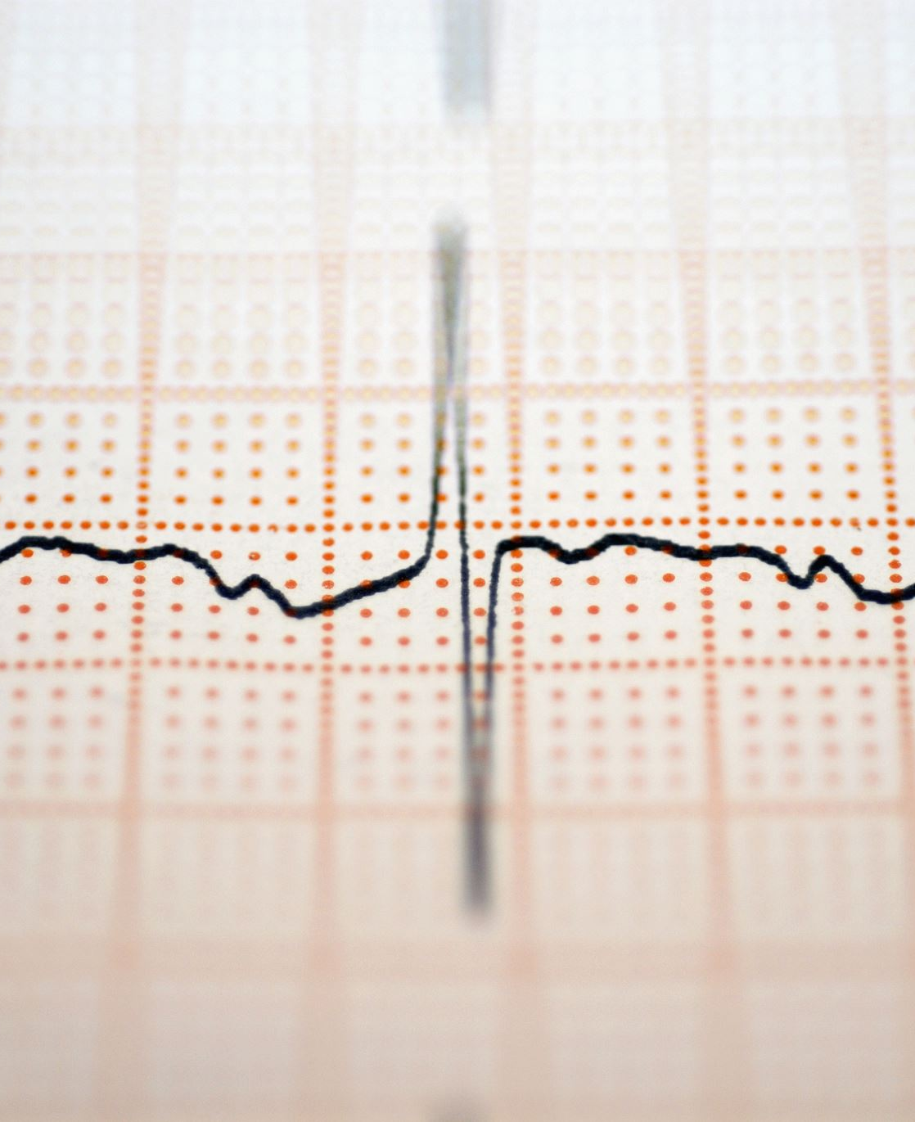
What is Cardiovascular Disease (CVD)?
Cardiovascular disease (CVD) is an umbrella term referring to conditions that affect the heart or blood vessels. CVD is the leading cause of death in both men and women and people of most racial (and ethnic) groups in the United States. It is estimated that one person dies every 34 seconds in the united states from CVD. Furthermore, CVD accounts for over a third of all deaths worldwide.

Slide 3
Problem statement
The purpose of this project was to create a model that predicts CVD given certain features. The nature of the problem is a difficult one, so the performance(s) of the model were expected to be moderately accurate at best. I kept feature engineering to a minimal. I did not add any additional variables to the analysis. However, I did hyperparameter tuning on all classification models used.

Slide 4






Where and to whom could such CVD prediction models be of use?
Healthcare Companies

Slide 5

Model Implementation
Such CVD prediction models could be implemented in preventive medicine protocols, especially for those at moderate or high risk of developing CVD.
Also, such models could be used in screening procedures, where primary care units can use them to better admonish patients on several life choices.

Slide 6

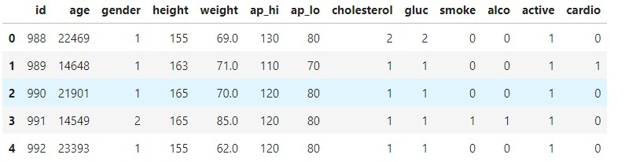
Data
The data was obtained from Kaggle. The data contains over 48,000 observations and 12 columns. The data was created on 1/20/2019.

Slide 7
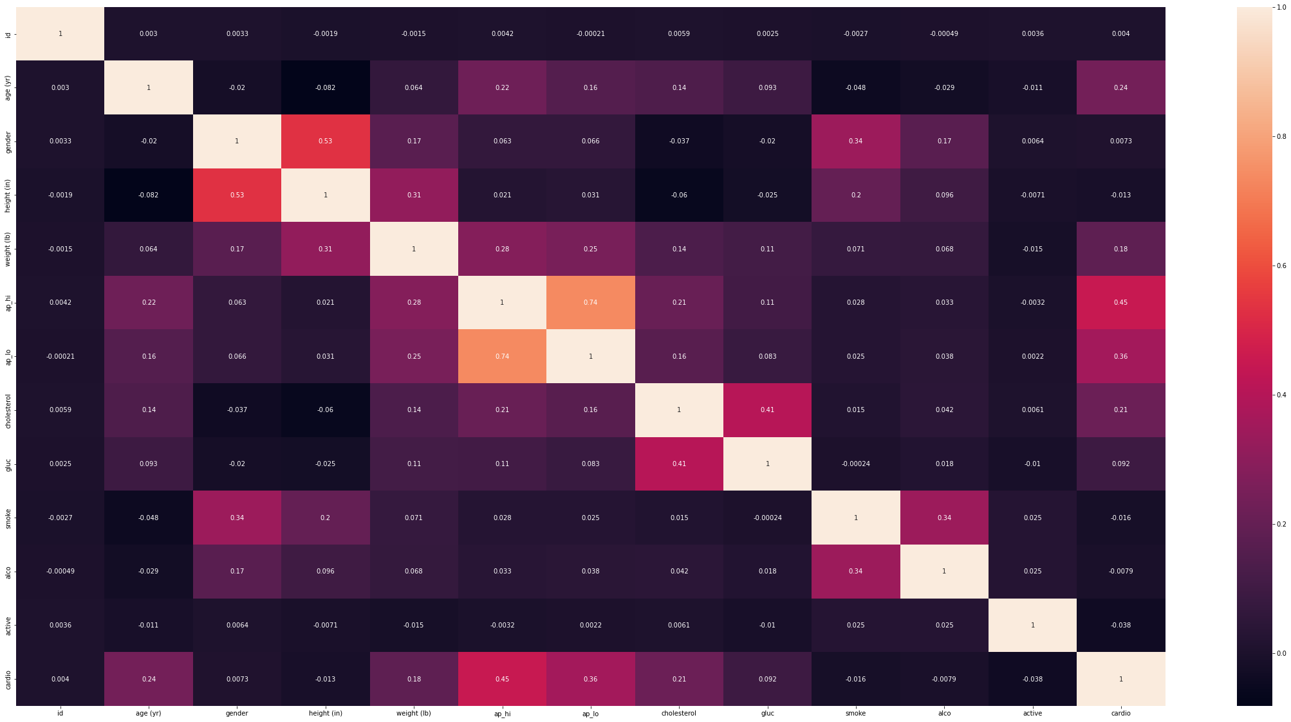
Which factor(s) is/are most correlated with CVD?
I checked to see if any monotonic correlations hold among the variables. Unsurprisingly, the two blood-pressure variables in the data were positively moderately correlated with CVD, while the age and cholesterol variables were, too, positively correlated with CVD, but only weakly.

Slide 8

Modeling
I used several classification models –namely:
K-Nearest Neighbors
Logistic Regression
Decision Tree
Random Forest
Additionally, I did hyperparameter tuning on all of them –in specific, I used GridSearchCV on the first three models listed and RandomSearch on the random forest model.

Slide 9
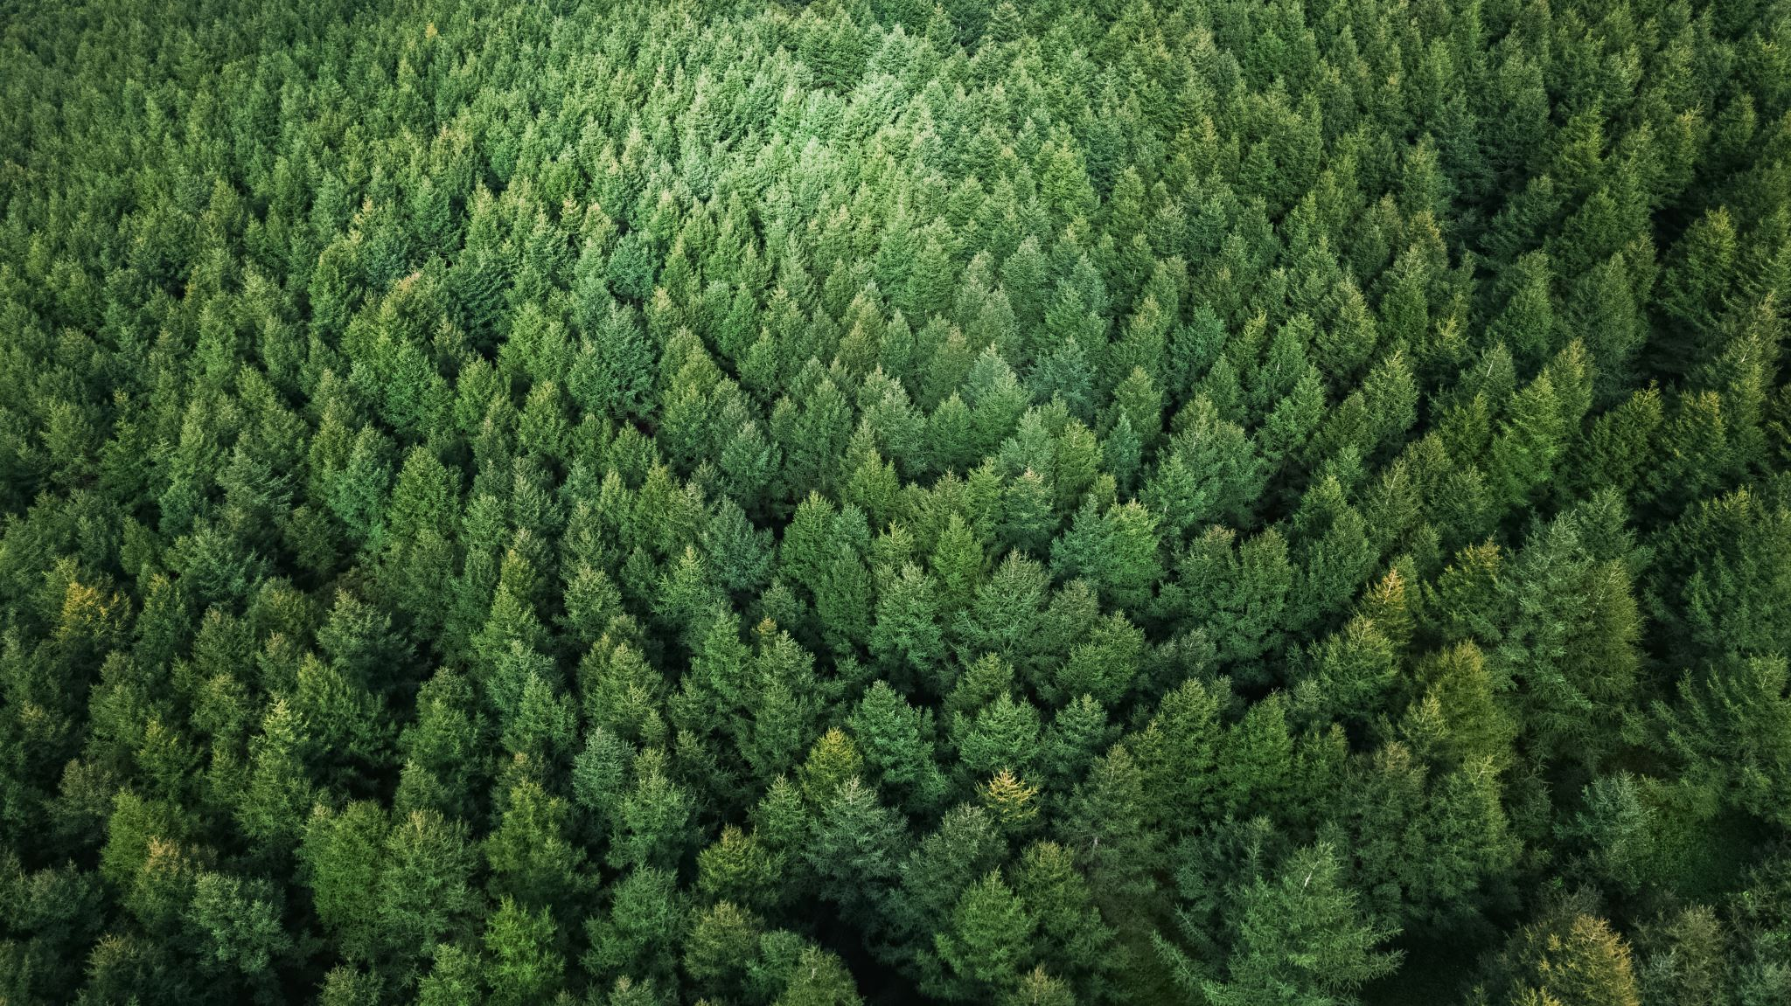
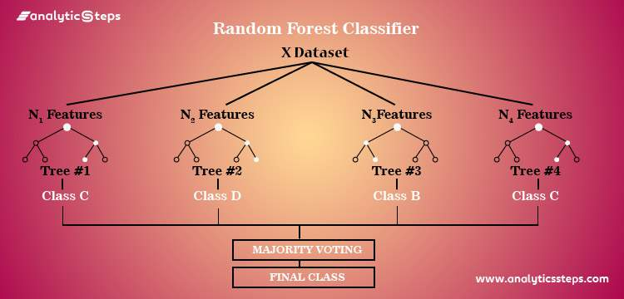
Winning Model: Random Forest

Slide 10

Results
The base random forest model performed best in terms of accurately predicting CVD among individuals. The accuracy score of the model ended up being about 72%. The results weren’t awfully surprising given the nature of the problem (as mentioned in the introduction).
Some of the takeaways are that (1) performance could’ve been improved given more feature engineering and data manipulation, (2) predicting CVD is difficult and leaves an air of ambiguity, but (3) efforts like this simple analysis show that achieving moderate predictive power from a model is doable.

Slide 11
Kevin Egocheaga
Aspiring Data Scientist
Contact Information:
Email: kegocheaga@yahoo.com
LinkedIn: https://www.linkedin.com/in/kevinmegocheaga/
GitHub: https://github.com/kevinegoch
Thank you!

